Slide 1
Java 4 WEB
Lesson 10 - Home Task Overview

Slide 2
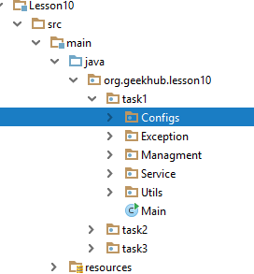
1. Naming convention violation

Slide 3

1. Naming convention violation

Slide 4
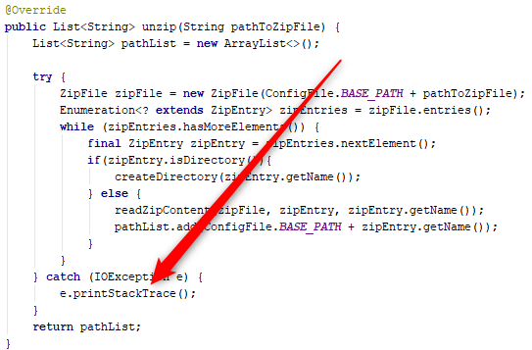
2. Incorrect exception handling

Slide 5
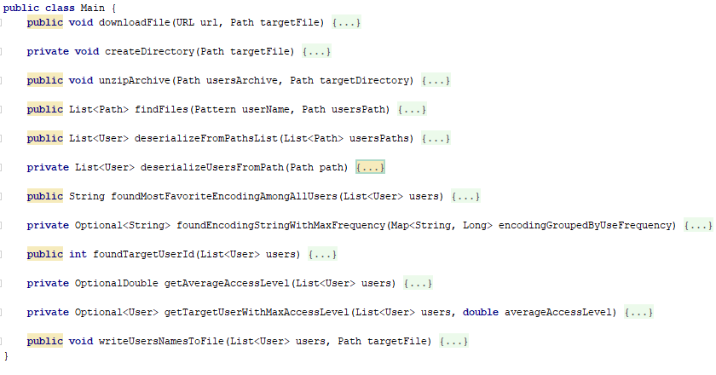
3. Where is the main?

Slide 6
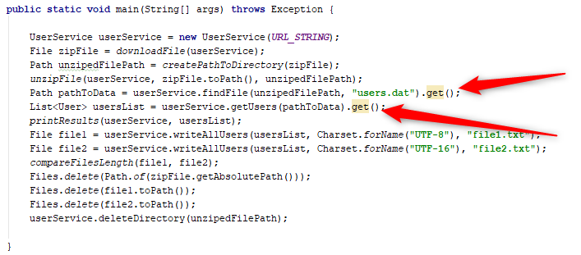
4. Unsafe optional unpack

Slide 7
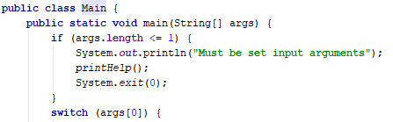
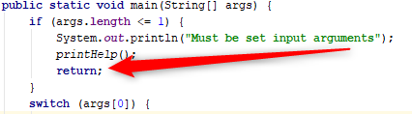
5. Avoid manual JVM shutdown

Slide 8
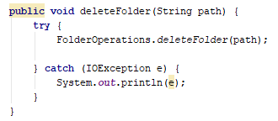
6. Incorrect exception handling

Slide 9
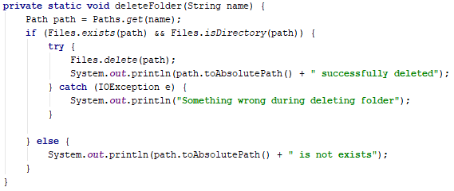
7. Incorrect task implementation
Notes:
Should be able to remove also non-empty folder

Slide 10
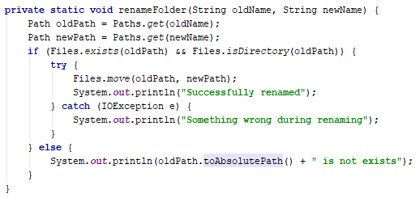
7. Incorrect task implementation
Notes:
Should prompt for replacement

Slide 11
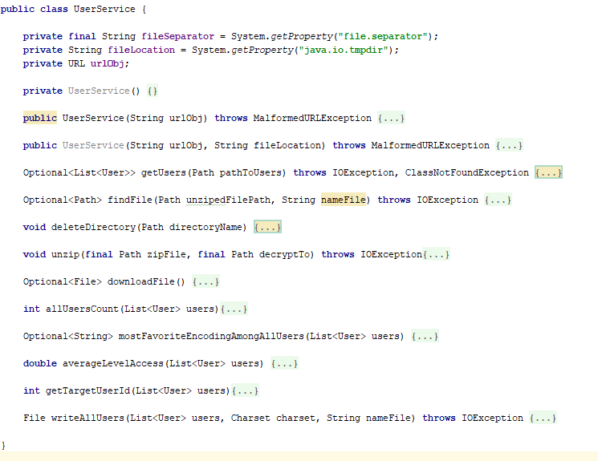
8. Not a single responsibility
Notes:
Think about extraction of UserSource and SerializedDataUserSource as implementation. The same for zip source and other classes

Slide 12
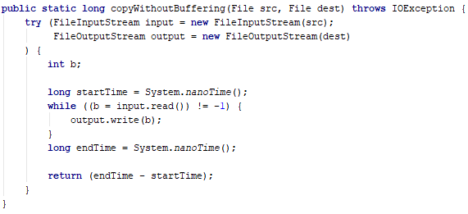
8. Not a single responsibility
Notes:
Method signature should tell enough info about method and remove necessity to look on implementation

Slide 13
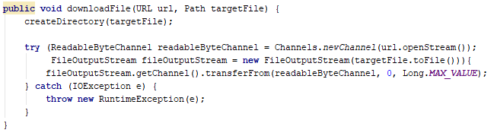
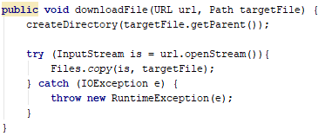
9. KISS

Slide 14
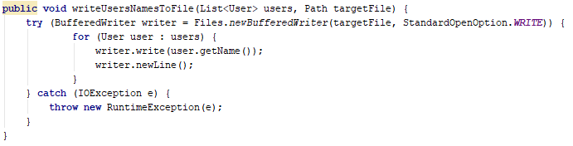
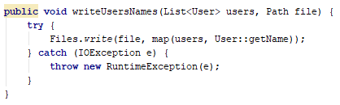
9. KISS
Notes:
Reuse existing built-in JDK code
Self-descriptive naming

Slide 15
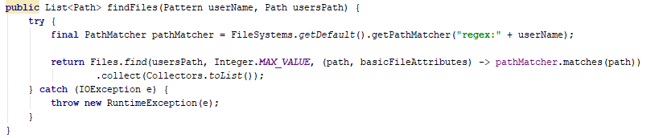
9. KISS
Notes:
There is not necessity to find all files

Slide 16

10. Self-descriptive naming

Slide 17
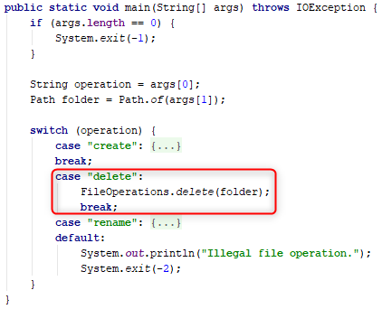
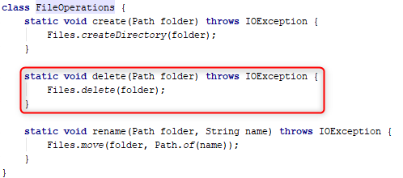
11. Delegation is not always correct solution
Notes:
We are writing the programs to make them handy

Slide 18
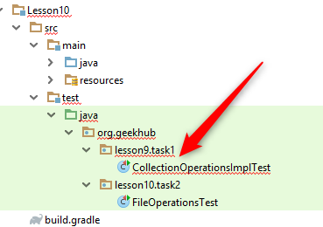
12. Out of scope code

Slide 19


13. Do atomic opertaions

Slide 20
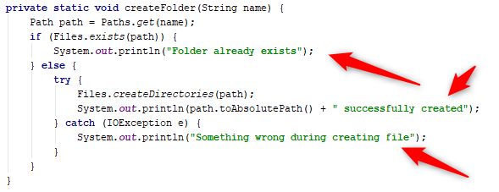
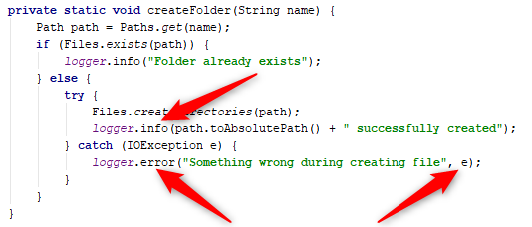
14. Use flexible logging
Notes:
Use correct log level
Why log is needed? Give as much helpful info as possible. Log should help to solve the problem nut not just print trash
In all future tasks use custom Logger approach. This is useful for example in case of fatal errors send an email to some responsible person.

Slide 21
Home task
Fix all issued to all previous home tasks
Implement tasks which has 0 mark
Read and apply knowledge from “Clean Code” to all home tasks

